Slide 1
OFFER VERSUS SERVE
LUNCH & BREAKFAST K-12

Slide 2
Why Offer vs. Serve?
Allows the student to select foods they want to eat
Reduces waste
Schools will be fiscally responsible by preparing or ordering meals based on student preferences
Opportunity to learn healthy eating while in the lunchroom or classroom

Slide 3
Offer vs. Serve IS IT MANDATORY OR OPTIONAL?
Offer vs. Serve is mandatory for students at senior high schools (as defined by the State educational agency)
Offer vs. Serve is optional for middle and elementary schools (as defined by the State educational agency)
Offer vs. Serve at breakfast is optional for all grades
Offer vs. Serve for summer meals (seamless summer option) is optional

Slide 4
LUNCHES

Slide 5
Offer vs. Serve Lunch Basics
The meal pattern for lunches consists of five food components
1. Fruits
2. Vegetables
3. Grains
4. Meats/meat alternates (M/MA)
5. Milk

Slide 6
Age/Grade Groups for Lunches:
K-5
6-8
9-12

Slide 7
Full Components: WHAT MUST BE OFFERED DAILY?
K-5 & 6-8
Must be offered Daily:
1 oz. Meat/MA
¾ c. Vegetable
½ c. Fruit
1 oz. Whole Grain-Rich Grain
8 oz. Milk
GRADES 9-12
Must be offered Daily:
2 oz. Meat/MA
1 c. Vegetable
1 c. Fruit
2 oz. Whole Grain-Rich Grains
8 oz. Milk

Slide 8
What Must Each Student Select Regardless of Grade Level for the Meal to be Reimbursable?
3 of the 5 food components AND:
1 of the 3 components MUST be ½ cup serving of the fruits or vegetable component or ½ cup total serving of both fruit and vegetable
2 of the 5 components may be declined

Slide 9
Fruit/Vegetable ½ CUP REQUIREMENT
Each student must select:
OR
OR
½ cup Fruit
½ cup Vegetable
½ cup combination of Fruit and Vegetable

Slide 10
What if 2 of the 3 Components ARE FRUIT AND VEGETABLE?
If a student selects only 3 components and 2 of the 3 are fruit and vegetable, one of those must be ½ cup and the other must be full component.
Example – If a student selects a banana for their ½ cup requirement and selects carrots for their second component, the carrots must be the full component. Grades K-8 vegetable requirement is ¾ cup and grades 9-12 is 1 cup. A student in grade 5 would need to select ¾ c. of carrots for these two items to be considered as 2 components.

Slide 11
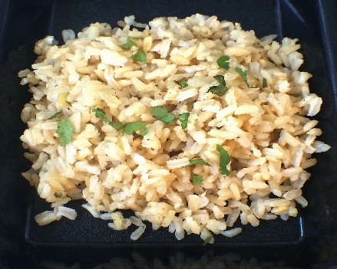
Is this K-8 Meal Reimbursable?
Menu K-8:
NO, THIS IS NOT A REIMBURSABLE MEAL BECAUSE THE REQUIREMENT ½ CUP FRUIT OR VEGETABLE WAS NOT SELECTED.
Student Selects:
Pineapple Chicken Breast (2 oz. M/MA)
Rice Pilaf ½ c.
Fresh Broccoli ¾ c.
Sliced Oranges (1 whole)
Milk 8 oz.
Is this a reimbursable meal?
Pineapple Chicken (2 oz. M/MA)
Milk 8 oz.
Rice Pilaf ½ c.

Slide 12
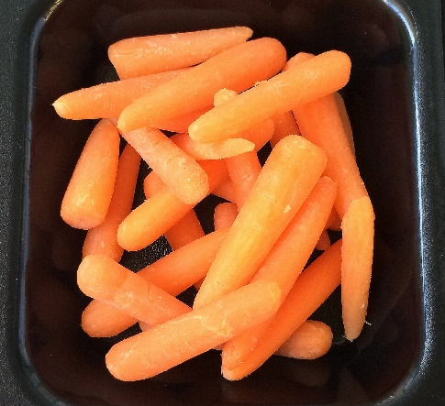
Is this K-8 Meal Reimbursable?
Menu K-8
Student Selects:
YES, THIS MEAL IS REIMBURSABLE BECAUSE ½ C. VEGETABLE OR FRUIT WAS SELECTED ALONG WITH TWO OTHER MEAL COMPONENTS. THIS PIZZA CONTRIBUTES 2 OZ. M/MA AND 2 OZ WHOLE GRAIN-RICH GRAINS.
Pizza
Applesauce ½ c.
Baby Carrots ¾ c.
Milk 8 oz.
Is this a reimbursable meal?
Baby Carrots ½ c.
Pizza (2 oz. M/MA & 2 oz. grain - meets 2 components)

Slide 13
Is this 9-12 Meal Reimbursable?
Menu 9-12
Student Selects:
YES, BECAUSE STUDENT SELECTED ½ C. FRUIT OR VEGETABLE AND THE PIZZA MET THE 2 OZ MINIMUM FOR WHOLE GRAIN-RICH GRAINS AND 2 OZ. MEAT/MA
Pizza
Applesauce 1 c.
Carrots 1 c.
Milk 8 oz.
Is this a reimbursable meal?
Carrots ½ c.
Pizza (2 oz. M/MA & 2 oz. grain - meets 2 components)

Slide 14
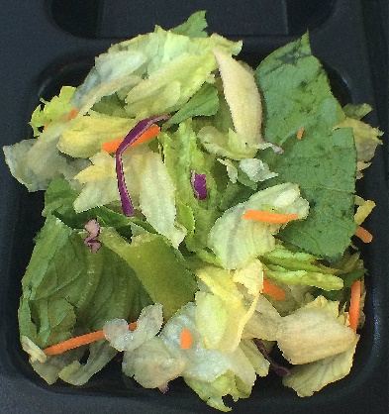
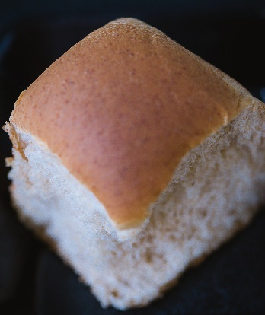
Is this K-8 Meal Reimbursable?
Tricky Scenario! Note the selected portion size of Vegetables & Fruit
Menu K-8:
YES, SALAD GREENS (1 C. = ½ C. CONTRIBUTION) MEETS THE ½ C. FRUIT OR VEGETABLE REQUIREMENT, APPLE MEETS ½ CUP WHICH IS A FULL COMPONENT FOR FRUIT GRADES K-8 AND DINNER ROLL MEETS THE DAILY 1 OZ. MINIMUM GRAINS.
Student Selects:
Chicken Breast 2 oz.
Salad Greens 1 c. (1/2 c. contribution)
Milk 8 oz.
Fresh Carrots ¼ c.
Dinner Roll 1 oz.
Fresh Apple ½ c. equiv.
Is this a reimbursable meal?
1 cup Salad Greens (½ c. vegetable)
Apple
Dinner Roll

Slide 15
Is this 9-12 Meal Reimbursable?
Tricky Scenario! Note the selected portion size of vegetables, fruit & grains.
Menu K-8:
Student Selects:
NO, SALAD GREENS (1 C. = ½ C. CONTRIBUTION) MEETS THE ½ C. FRUIT OR VEGETABLE REQUIREMENT. HOWEVER, FOR THIS AGE GROUP A FULL COMPONENT OF FRUIT IS 1 C. AND THE APPLE ONLY MEETS ½ CUP. ONE DINNER ROLL (1 OZ.) DOES NOT MEET THE MINIMUM OF 2 OZ. EQUIVALENTS OF GRAINS.
Chicken Breast 2 oz. Salad Greens 1 c. (1/2 c. contribution)
Milk 8 oz.
Pineapple Tidbits (½ c.)
Fresh Carrots ¼ c. 2 Dinner Rolls 1 oz. each
Fresh Apple (½ c. equiv.)
Is this a reimbursable meal?
1 cup Salad Greens (½ c. vegetable)
Apple
1 Dinner Roll

Slide 16
Identifying Meal Components
All serving lines must have a method to identify reimbursable meal components near or at the beginning of serving lines. This NSLP regulation can be found in more detail at 7 CFR 210.10(a)(2)
Students, cashiers, and meal servers must be able to clearly identify what constitutes a reimbursable meal. Daily training is encouraged
Place signage prior to the service line will give the students ample time to make decisions prior to the point of service

Slide 17
Sample Tray K-8
Great training tip: Prepare a meal tray daily that contains the required components for each grade group. This tray presentation will provide an excellent visual for your students
and the food service professionals who determine if the meal is reimbursable.
Chicken Nuggets - 2 M/MA
Chips - 1 oz. WGR
Cowboy Salad - ½ cup
Broccoli - ¼ cup
Strawberries - ½ cup
Milk - 8 oz.

Slide 18
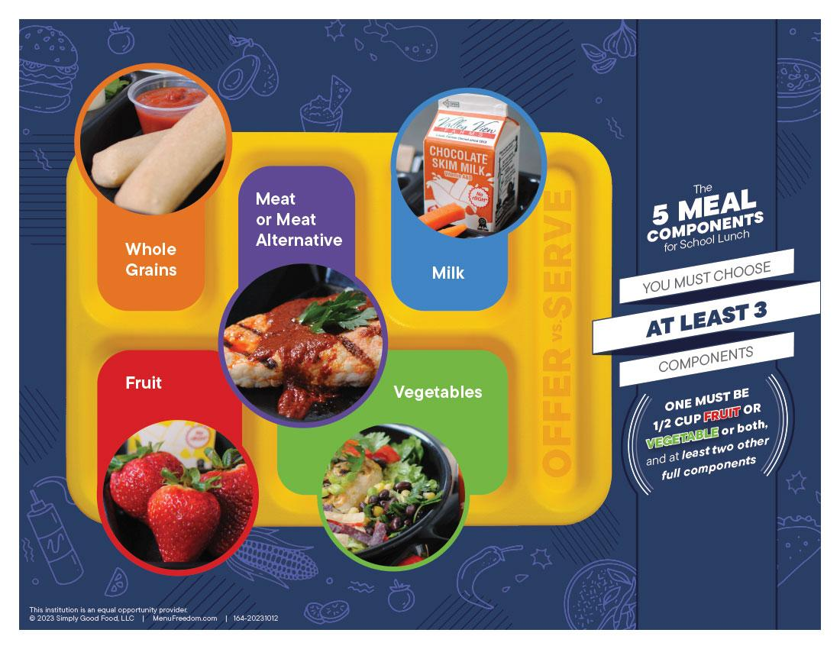
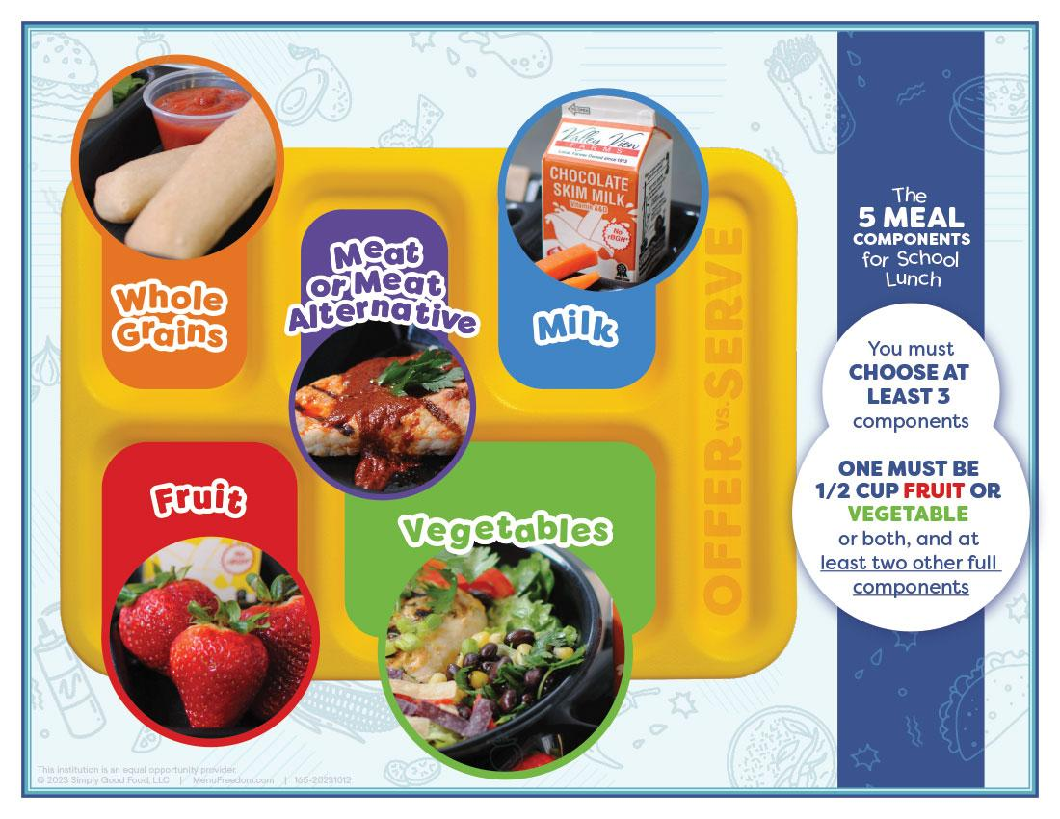
EXAMPLE POSTER THAT IDENTIFIES
The 5 Lunch Meal Components

Slide 19
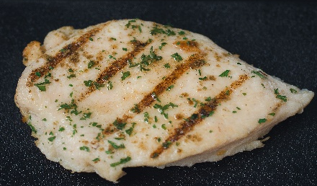
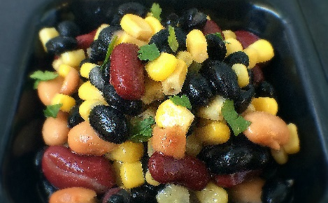
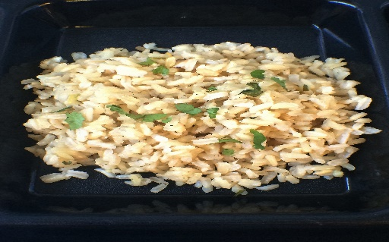
Meal Components
Each daily meal needs to be broken down into components so students understand what constitutes a reimbursable meal.
Pick 3 Components. One MUST be ½ c. Fruit OR Vegetable OR Both.
Grilled Chicken Breast 2 oz
1 Component
Cowboy Salad ½ c.
1 Component
Salad Greens 1 c.
1 Component
Apple or Sauce
1 Component
Cilantro Rice ½ c.
1 Component
Milk Variety
1 Component

Slide 20
BREAKFAST

Slide 21
Offer vs. Serve At Breakfast
Offer vs. Serve at breakfast is optional for all grade levels
MEAL PATTERN FOR BREAKFAST CONSISTS OF THREE FOOD COMPONENTS:
Fruits (or vegetables substitution)
Milk
Grains (or optional credited meat/meat alternates). A school may offer meat/ma in place of grains after the minimum daily grains requirement of 1 oz. for all grade groups is offered. One oz. eq of m/ma may count as one oz. eq of grains to meet the weekly grains component requirement. The student does not have to select the grain item in order for the m/ma to credit as a grain on the students tray. For instance, if cereal (1 oz. bowl) and yogurt (4 oz.) is offered, the student may select just the yogurt. The yogurt would be credited as one of the 3 food items.

Slide 22
Grade Groups for Breakfast:
K-5
6-8
9-12

Slide 23
Breakfast OVS Menu Planning
At least 4 food items must be offered
All students, at any grade level, must select at least 3 food items
If a grain or meat/ma is selected it must be the daily minimum required amount
*Daily grain or meat/ma minimum requirement for all age groups is one ounce equivalent. Meat/ma is optional in place of grains after one ounce equivalent of grain has been offered

Slide 24
What is the Difference Between FOOD COMPONENT AND FOOD ITEM?
A Food Component is one of three food groups that comprise reimbursable breakfast
Schools must ALWAYS OFFER 3 FOOD COMPONENTS in at least the minimum daily required quantities
Fruits (or vegetables)
Grains (optional meat/ma)
Milk

Slide 25
What is the Difference Between FOOD COMPONENT AND FOOD ITEM?
A Food Item is a specific food offered within the three food components
A school MUST OFFER FOR THE PURPOSE OF OVS, AT LEAST FOUR FOOD ITEMS from the three required food components
THE STUDENT MUST SELECT 3 FOOD ITEMS, INCLUDING AT LEAST ½ CUP FRUIT OR VEGETABLES for that meal to be reimbursable

Slide 26
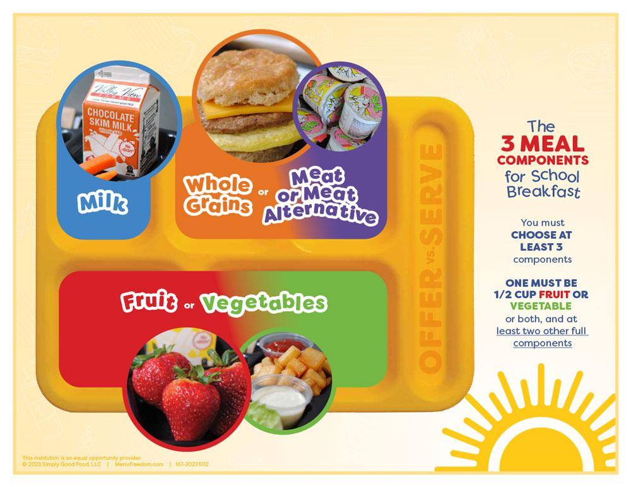
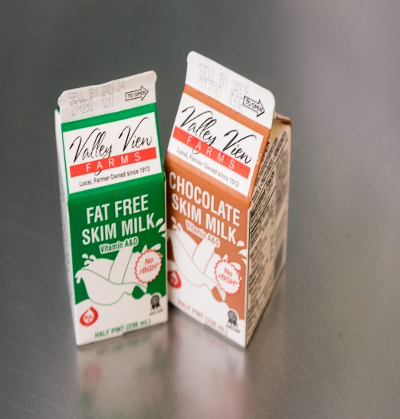
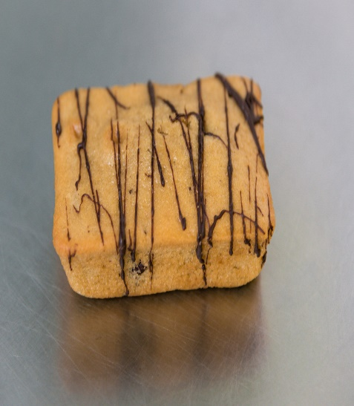
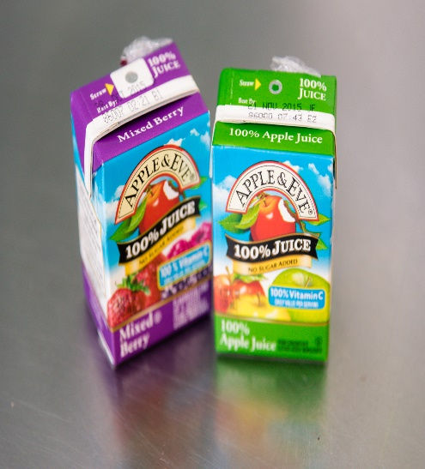
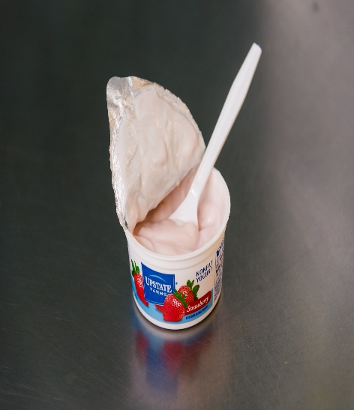
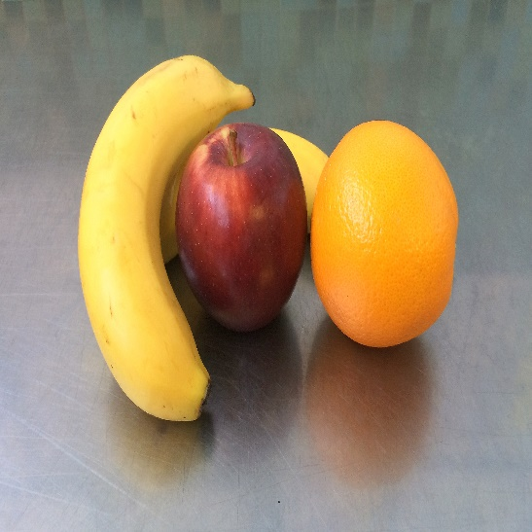
Breakfast Offerings Will Change Daily STUDENTS MUST BE AWARE OF OFFERINGS
Sample Poster - Pictures Provide Excellent Examples!
Today’s Offerings
Milk
Snack Bread
100% Fruit Juice
Yogurt
Fresh Fruit

Slide 27
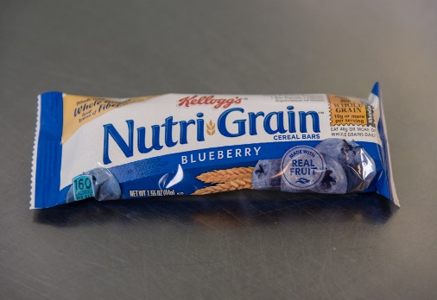
Is This a Reimbursable Breakfast ?
Menu:
YES, THIS MEAL IS REIMBURSABLE! 3 ITEMS ARE SELECTED, ONE OF WHICH IS A FRUIT!
Student Selects:
Nutri-Grain Bar (1 oz. grain equivalent)
Cereal (1 oz. grain equivalent
100% Fruit Juice (½ c.)
Raisins (1/2 c. equivalent)
Milk 8 oz.
Is this a reimbursable meal?
Nutri-Grain Bar (1 oz. grain equivalent)
Milk
Raisins (½ c. equivalent)

Slide 28
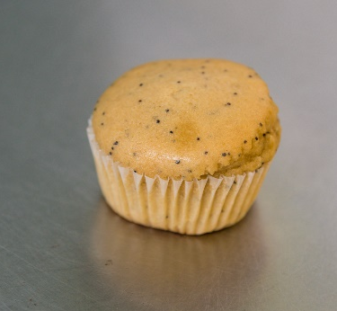
Is This a Reimbursable Breakfast ?
NO, EVEN THOUGH 3 ITEMS WERE SELECTED, A FRUIT ITEM WAS NOT. STUDENT MUST SELECT AT LEAST 1 FRUIT ITEM THAT IS ½ C. EQUIVALENT.
Menu:
Student Selects:
Yogurt ( 1 oz. meat/ma equivalent)
Poppy Seed Muffin (1 oz. grain equivalent)
100% Fruit Juice (½ c.)
Raisins (1/2 c. equivalent)
Milk 8 oz.
Is this a reimbursable meal?
Yogurt ( 1 oz. meat/ma equivalent)
Poppy Seed Muffin (1 oz. grain equivalent)
Milk

Slide 29
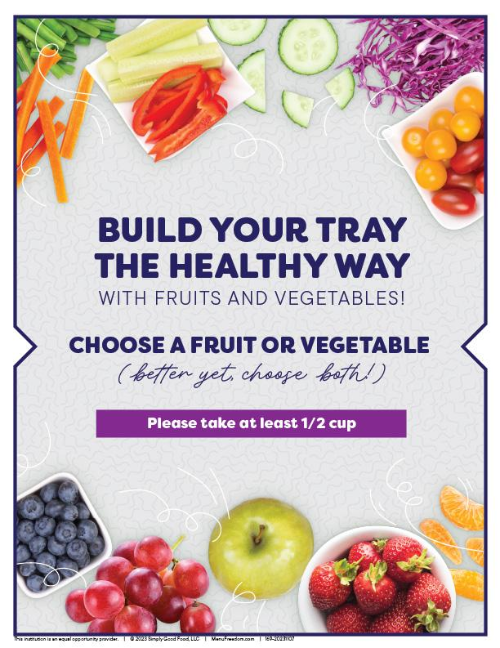
Posters can help students
WITH THEIR SELECTIONS

Slide 30
Additional Information
For information regarding Offer Versus Serve, visit http://www.fns.usda.gov/sites/default/files/cn/SP41_2015a.pdf

