Slide 1
Making the Most of Your School Breakfast Program
Presented by:
Jeanne Hopkins, RD
SNA-WI 2021 Annual Conference

Slide 2
Breakfast Fuels Achievement
Students who eat breakfast achieve an average 17.5% higher scores on standardized math test and attend 1.5 more days of school.
Students who attend school regularly are 20% more likely to graduated from high school.
Source: Share Our Strength and Deloitte. 2015.
Ending Childhood Hunger: A Social Impact Analysis

Slide 3
School Breakfast & Student Behavior
School breakfast participation, especially breakfast offered at no cost to students, positively impacts children’s mental health, including reductions in hyperactivity, anxiety, and depression.
Providing students with breakfast in the classroom is associated with:
Fewer disciplinary office referrals
Lower tardy rates
Improved attendance rates
Source: Food Research and Action Council (FRAC)

Slide 4
School Breakfast Benefits
Increased:
Standardized tests scores
Concentration
Alertness
Comprehension
Memory
Learning
Cognitive function
Participation
Nutrition
Sense of community
Decreased:
Tardiness
Behavioral issues
Anxiety
Depression
Absenteeism

Slide 5
Offering Breakfast Makes Cents
True, breakfast adds additional cost. However, student participation is high often enough to support the program and boost revenue, keeping you out of the red!
In a “severe need” school/district of 1,000 students, increasing participation 10% would yield $39,600 in additional revenue in just one school year:

Slide 6
DISCUSSION What challenges or barriers have you faced with offering a school breakfast program?

Slide 7
Engage Key Stakeholders
School staff are crucial stakeholders. Their cooperation and support is integral to a school breakfast program’s success.
Be considerate of stakeholders:
Principals
Custodial staff
Teachers

Slide 8
Principals and Administrators
Potential concerns include:
Scheduling
Additional food, labor costs
Lack of resources
Low participation

Slide 9
Custodial Staff
Potential concerns include:
Additional workload
Increased waste
Classrooms will become messy

Slide 10
Teachers
Potential concerns include:
Interference in instructional time
Workload
Classroom order
Time commitment

Slide 11
DISCUSSION If you have a breakfast program, what are some of your successes?

Slide 12
Determine a Style That Works For You
Cafeteria Service
Grab and Go (GNG)
Breakfast in the Classroom (BIC)

Slide 13
Cafeteria Service
Benefits:
Wider variety of foods can be offered, including heated options such as burritos or breakfast sandwiches.
Challenges:
Must be served before the bell.
More foodservice staff needed to prepare, serve, clean up.
Students eating in cafeteria may be perceived as low income by their peers.

Slide 14
Grab and Go
Benefits:
Popular with middle and high school students.
Avoids the low-income stigma association with cafeteria-served breakfast.
Challenges:
Requires moveable breakfast carts and/or display racks.
Often limited to fruits and packaged foods (yogurt, cereal bars).

Slide 15
Breakfast in the Classroom
Benefits:
Offered after the bell, so especially good for students arriving late.
Great for elementary schools that qualify for the Community Eligibility Provision (free meals for all students).
Challenges:
Concerns it will burden classroom teachers and result in messy classrooms.

Slide 16
Breakfast in the Classroom

Slide 17
What to Serve?
USDA guidelines require four components be offered daily:
1 and 2 whole-grain rich equivalent items
Fruit
Milk
Protein items
Students are required to take a fruit or vegetable and two other components to qualify for reimbursement.
Vary your menus and include kid-friendly options to keep students interested and eating.

Slide 18
Offer Versus Serve The 3 Meal Components for Breakfast

Slide 19
Presentation Matters
Hallways provide easy access.
Use racks and serving bowls to present a variety of items in a visually appealing manner.
Salad bars make great breakfast bars!

Slide 20
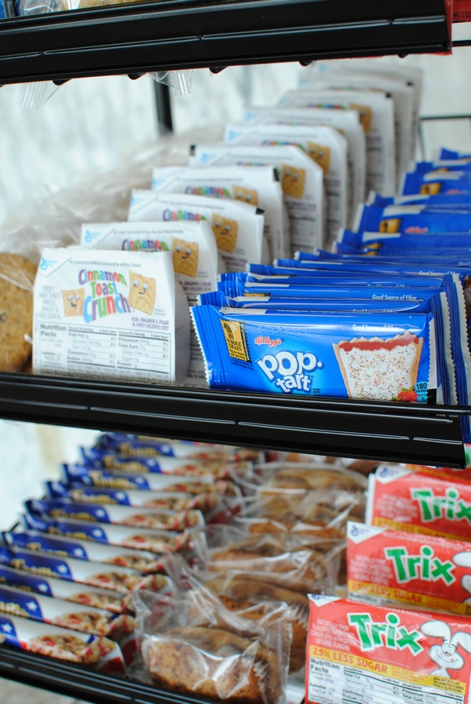
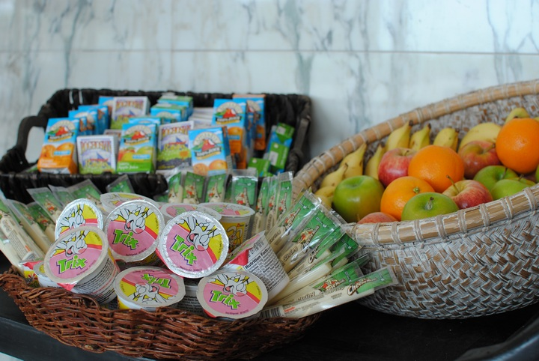
A breakfast rack is a perfect option for cafeteria or hallway breakfast. Presenting components in a visually appealing manner can help build participation!

Slide 21
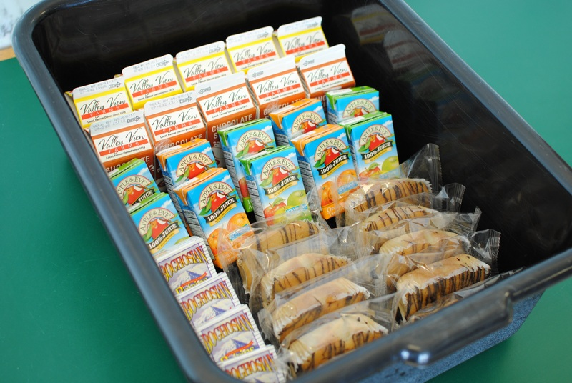
Breakfast totes with grains, fruit offerings and milk can be prepped before students arrive and distributed to classrooms.

Slide 22
Incorporate proteins such as yogurt and cheese sticks in your breakfast planning.

Slide 23
Marketing
USDA requires promotion of your School Breakfast Program.
How to get the word out?
Post details on district website
Use district-wide communication channels – email, social media
Participate in National School Breakfast Week in March
Share the NutriStudents K-12 Cafeteria Connection “breakfast” edition
Engage students
Ask for student input on menu choices and decision making
Involve students in responsibilities (i.e. cleaning up after BIC)

Slide 24
Funding Your Breakfast Program
Seek out grants to offset costs associated with changing the service style of your breakfast program:
Action for Healthy Kids
Fuel Up to Play 60
Food Research and Action Council
Partners for Breakfast in the Classroom

