Slide 1
Successfully Addressing Schools' Foodservice Needs Nationally

Slide 2
The National School Lunch Program is severely challenged. 80% of schools dependent on USDA reimbursements lack the resources to meet the federal government’s strict requirements, resulting in increased costs, reduced participation/revenue and increased staff time requirements to remain compliant. (National Center for Education Statistics)

Slide 3
Your Foodservice Can Be A Profit Center
Only one company guarantees:
Increased revenue
Reduced cost
Reduced waste
Reduced administrative time
Ensured RD-certified, USDA compliance

Slide 4
NutriStudents K-12: A robust plug-and-play, self-operated foodservice platform helping foodservice directors run profitable and efficient, USDA-compliant child nutrition programs with a 45-week rotation of student-approved menus and behind-the-lines support.
Notes:
Easy-to-use web-based system available 24/7
100+ weeks of kid-tested and approved, USDA-compliant menus

Slide 5
Training resources
Administrative Review support
Promotional tools
45-week rotation of student-approved, USDA-compliant menus
Scalable recipes
& compliance reports available to download 24/7
Simplified market basket, inventory and order mgmt
Productivity Tools: Breakfast Menu Builder, Commodities Forecasting Tool
Notes:
This simple flow chart shows you only some of what’s in our program

Slide 6
Student-Approved, USDA-Compliant Menus
Full 45-week rotation for all K-12 NSLP and CACFP age groups
Taste-tested and widely accepted by students
Certified by Registered Dietitian to all USDA requirements

Slide 7
Student-Approved, USDA-Compliant Menus
Each week includes:
Daily Food Production Reports
Compliance reports
Step-by-step, scalable recipes with HACCP procedures
Daily promotional posters

Slide 8
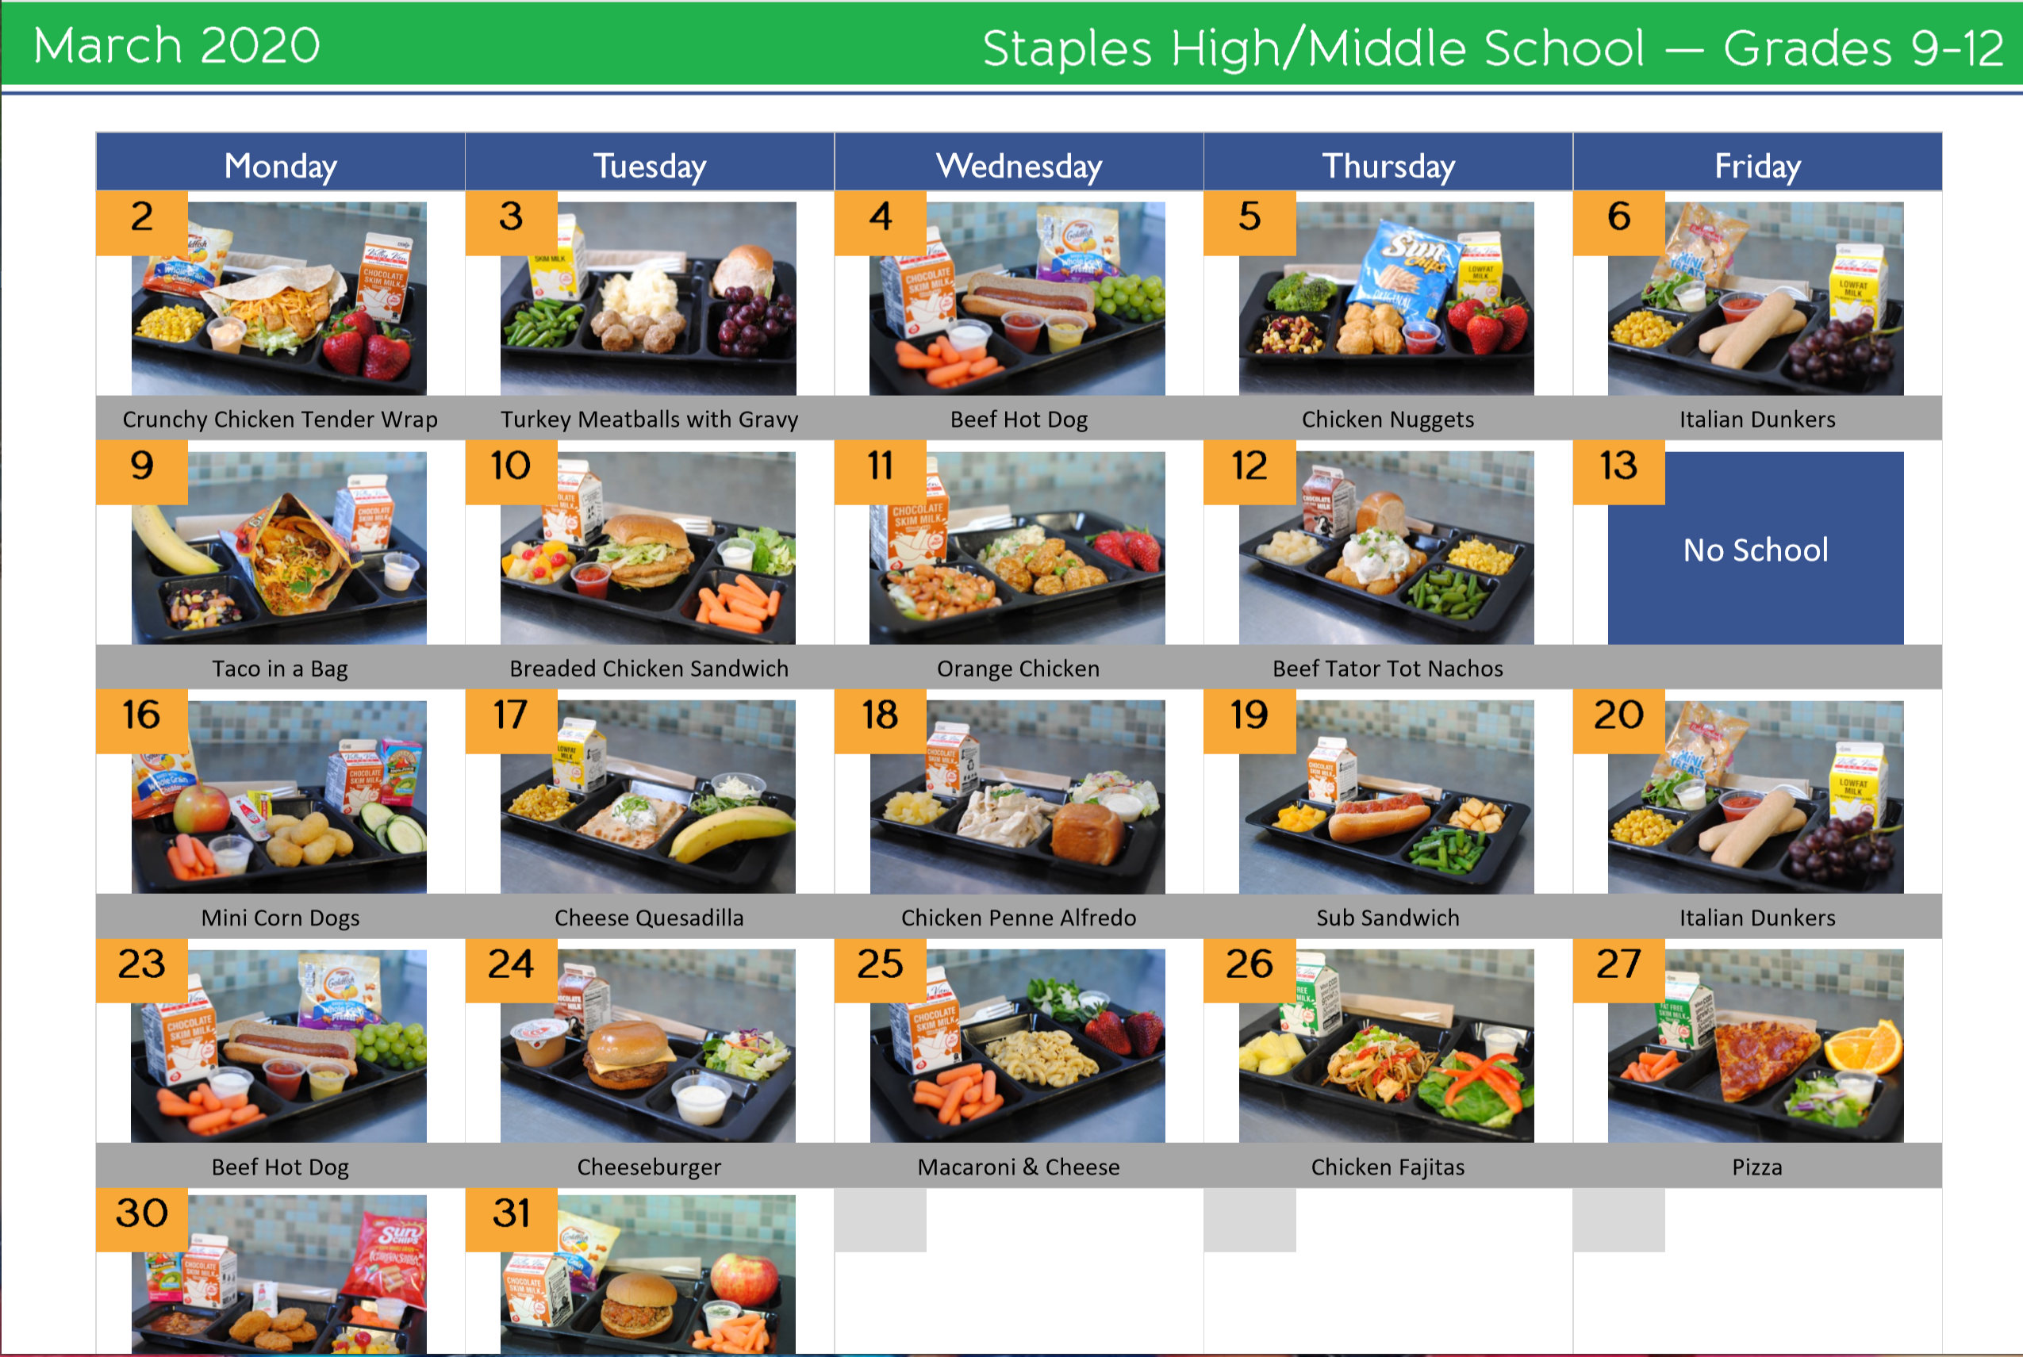
Kids Eat With Their Eyes
Daily, weekly or monthly pictorial menus increase student participation while inspiring and enhancing cooks’ meal preparation and meal presentation for service.

Slide 9
Semi-Automated Preparation, Reporting and Purchasing
What would you and your staff do with an extra hour per day?
Semi-automated Food Production Reports save 4-5 hours per week.
Automated order management system saves 1-2 hours per week.
Automated USDA compliance reports.
All recipes are instantly sized to the number of students served, saving 2-3 hours per week.

Slide 10
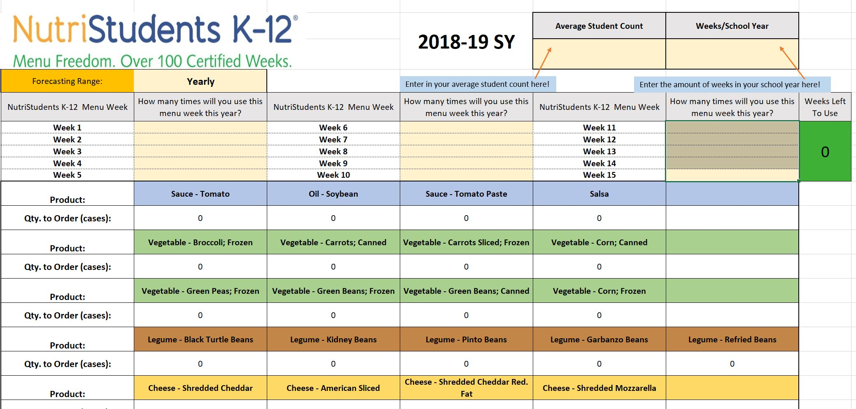
Simplify Commodity Ordering and Reduce Food Waste
Our “commodities first” menus ensure maximum use of your USDA Foods (Commodities) and the financial success of your foodservice program.
Our USDA Commodity Calculator accurately predicts commodities use in 15 minutes – a job foodservice directors often spend 30 or more hours doing!
USDA Commodity Forecasting Tool
Notes:
Value-added features:
USDA Commodity Forecasting Tool

Slide 11
Value Adds
USDA Administrative Review Support ensures nutritional compliance.
Automated Breakfast Menu Builder saves time & increases revenue.
CookBook instantly scales recipes for the day or week.
Inventory and order management capabilities save hours/week.
USDA Commodity Calculator: plan commodity use in 15 minutes vs. 30 hours.
Cafeteria posters encourage participation and healthy meal choices.
Promotional materials: daily menu posters, promotional calendar creator, pictorial menus for 45-week rotation.
Cafeteria Connection newsletter for parents increases participation and community support.

Slide 12
Client Testimonials
“NutriStudents K-12 is the best thing that happened to me in my foodservice career.”
- Sue Motzko
“The kids love the food...I haven’t had one single complaint!”
- Sue Motzko
“Our food waste was decreased by as much as 30-40% less than last year.”
- Tom Marcussen
“The kids are excited about breakfast and lunch. Participation has increased much more than we expected: From 500 to 700 every day.”
- Crystal Vang
“This doesn’t look or taste like school lunch. It’s absolutely awesome!”
- Shelly Miller
“Foodservice directors would have to be out of their mind not to use this program!”
-Crystal Gauss
“I’m so pleased with my lower food cost.”
- Shelly Miller
“My whole job is easier…less time doing food prep and cooking…”
- Judy Gertz

Slide 13
Follow the Money: Proven Financial Success
Consistent Profitability
Student participation/revenue levels increase by up to 25%*.
USDA commodities used first in all menus, further reducing costs.
Concise market basket gives distributor greater buying power, reducing cost per plate.
Plate waste decreases up to 40%*.
Reduced daily prep and administrative workload saves hours per week.
Foodservice programs operate profitably*.
* See MenuFreedom.com for validated testimonials and case studies.

Slide 14
Return On Investment
Expected first year participation/revenue increase: 10%
At $648 per student, how much increased revenue will you gain if you increase participation by just 5%?
Full money back guarantee if not satisfied with first-year results.

Slide 15
Return On Investment
Example first-year results:
Prairie Seeds Academy: $112,000 revenue increase
Park Rapids Area Schools: 30-40% reduction in plate waste
Hanover (PA) Schools: daily participation increase of 25% in middle school
Verndale Public Schools: “NutriStudents K-12 makes my whole program a lot less stressful,” Vickie Thompson, FSD

Slide 16
Return On Investment - Staples-Motley Schools
First-year results:
Increase in daily ave. meal count: 10%
Plate-waste reduction: approx. 20%
Increased revenues: $56,100
Staff time saved: 90 minutes/day
Ongoing results:
Annual budget surplus
2017-2018 surplus used to purchase 2 milk coolers and for unplanned equipment maintenance
2018-2019 surplus exceeded previous year

Slide 17
Love It or It’s Free. Period.
If you use NutriStudents K-12 for one year as intended and are not fully satisfied for any reason, we will refund 100% of your first-year investment. (See Subscription Agreement for details.)

Slide 18
Pricing: Transparent, Concise
One-time setup fee and monthly subscription payable over 12 months.
One-Time Setup Fee/District
Four schools or less $1,995
Each additional school $209
Monthly Subscription
Four schools or less $289/month
Each additional school $49/month

Slide 19
Questions? Amanda@NutriStudentsK-12.com 844.204.2847

