Slide 1
Successfully Addressing Schools' Foodservice Needs

Slide 2
The National School Lunch Program has never been more severely challenged. 80% of schools dependent on USDA reimbursements lack the resources to meet the federal government’s strict requirements, resulting in increased costs, reduced participation/revenue and increased staff time requirements to remain compliant. (National Center for Education Statistics)

Slide 3
Your Foodservice Can Be A Profit Center Only one company guarantees: - Increased revenue - Reduced costs - Reduced waste - Reduced administrative time - Ensured RD-certified USDA compliance

Slide 4
NutriStudents K-12: A robust plug-and-play, self-operated platform helping foodservice directors run profitable and efficient, USDA-compliant child nutrition programs with more than 45 weeks of student-approved menus and behind-the-lines support.

Slide 5
Training resources
Administrative Review support
Promotional tools
45 weeks of student-tested and approved, USDA-compliant menus
Scalable recipes
& all compliance reports to download
Simplified market basket, inventory and order mgmt
Productivity Tools: Breakfast Menu Builder, Commodities Forecasting Tool

Slide 6
Extensive Library of Student-Approved, USDA-Compliant Menus
Each week includes:
Semi-automated, daily Food Production Reports
Automated compliance reports
Step-by-step, instantly-scalable recipes with HACCP procedures
Daily promotional posters, digital display images

Slide 7
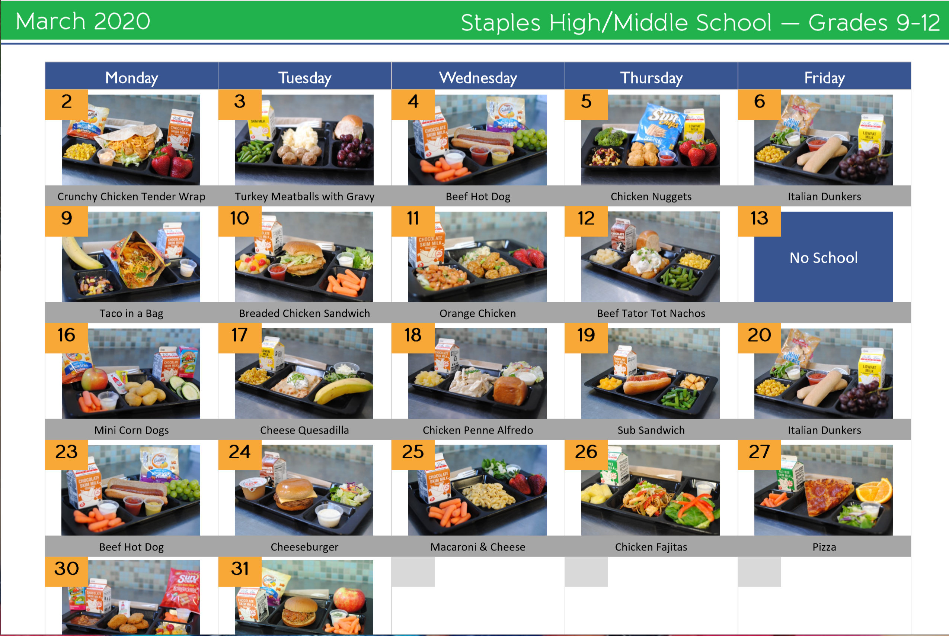
Kids Eat With Their Eyes!
Daily, weekly, or monthly pictorial menus increase student participation. The cooks’ meal preparation and serving presentation are inspired and enhanced by these actual menu photos.

Slide 8
Semi-Automated Preparation, Reporting and Purchasing
What would you and your staff do with an extra hour per day?
Semi-automated Food Production Reports save 4-5 hours per week.
Automated order management system saves 1-2 hours per week.
Automated USDA compliance reports.
All recipes are instantly sized to the number of students served, saving 2-3 hours per week.

Slide 9
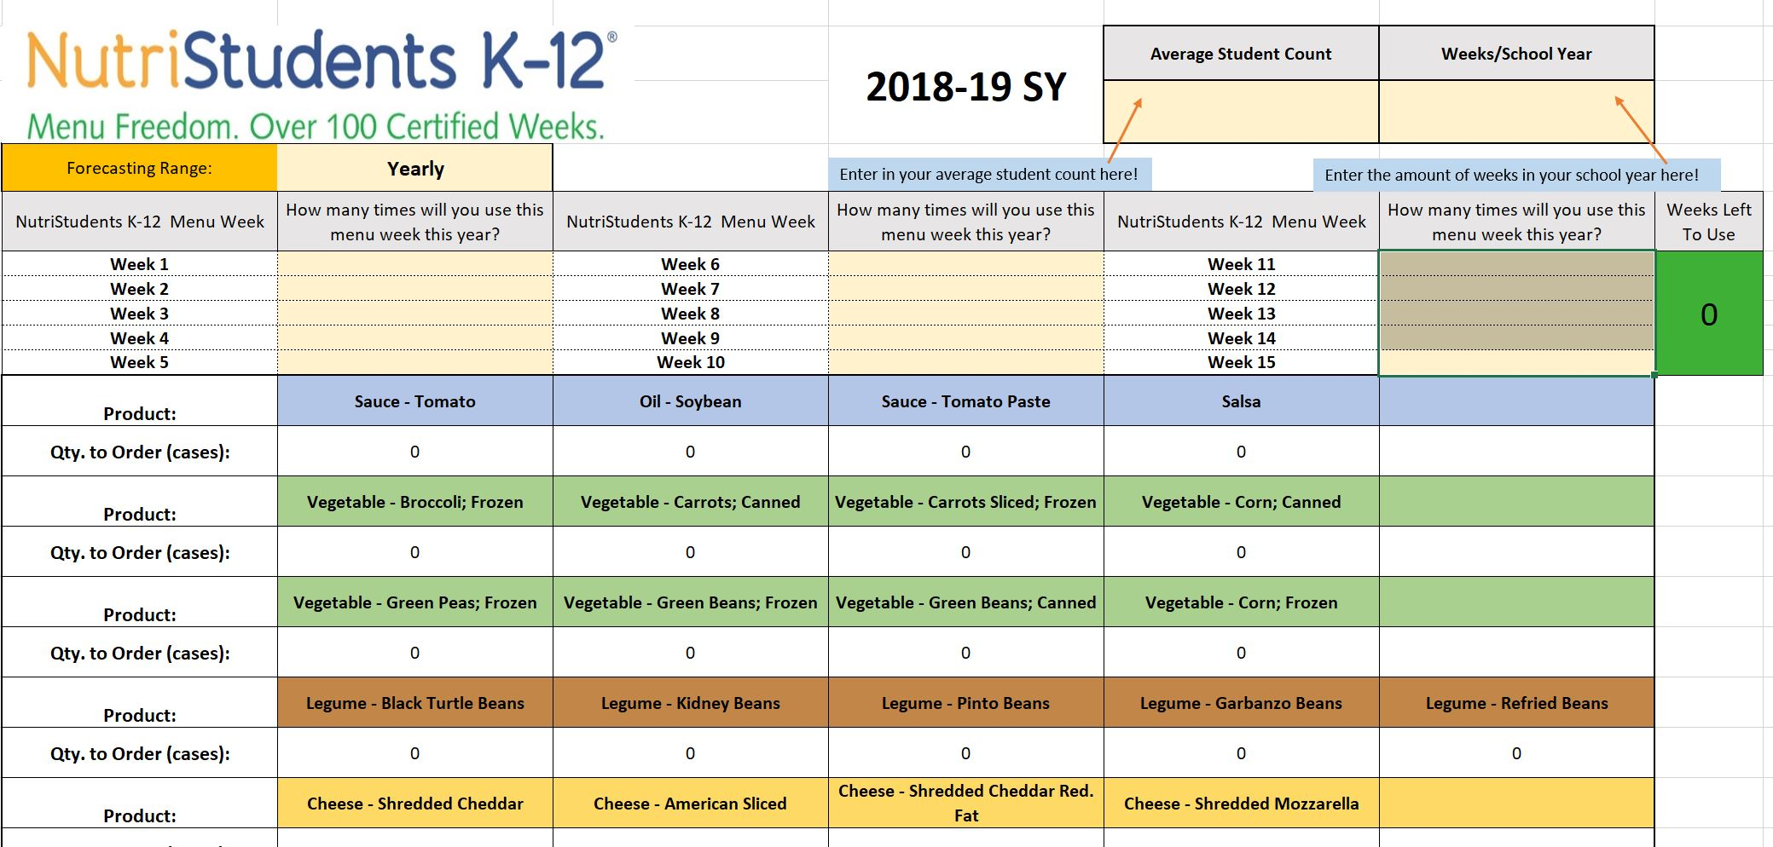
Simplify Commodity Ordering and Reduce Food Waste
Making full use of your USDA Foods (Commodities) first in all menus is one way to ensure the financial success of your foodservice program.
Our USDA Commodity Calculator does in 15 minutes what foodservice directors often spend 30 or more hours/year figuring out, with 90% accuracy!
USDA Commodity Forecasting Tool

Slide 10
Value Adds
USDA Administrative Review Support ensures nutritional compliance
Automated Breakfast Menu Builder saves time & increases revenue
CookBook instantly scales recipes for the day or week
DataBites™ Inventory and automated Order Management System saves hours/week
USDA Commodity Forecasting Tool: 15 minutes vs 30 hours
Cafeteria Posters encourage participation and healthy meal choices
Promotional materials: daily menu posters, digital display images, promotional calendar creator, pictorial menus for full 45-week rotation
Cafeteria Connection newsletter for parents increases participation and community support

Slide 11
Client Testimonials
“NutriStudents K-12 is the best thing that happened to me in my foodservice career.”
- Sue Motzko
“The kids love the food...I haven’t had one single complaint!”
- Sue Motzko
“Our food waste was decreased by as much as 30-40% less than last year.”
- Tom Marcussen
“The kids are excited about breakfast and lunch. Participation has increased much more than we expected: From 500 to 700 every day.”
- Crystal Vang
“This doesn’t look or taste like school lunch. It’s absolutely awesome!”
- Shelly Miller
“Foodservice directors would have to be out of their mind not to use this program!”
-Crystal Gauss
“I’m so pleased with my lower food cost.”
- Shelly Miller
“My whole job is easier…less time doing food prep and cooking…”
- Judy Gertz

Slide 12
Follow the Money: Proven Financial Success
Consistent Profitability
Student participation/revenue levels increase by up to 25%*
USDA commodities used first in all menus, further reducing costs
Concise market basket gives distributor greater buying power, reducing cost per plate
Plate waste decreases up to 40%*
Reduced daily prep and administrative workload saves hours per week
Foodservice programs operate profitably*
* See MenuFreedom.com for validated testimonials and case studies.

Slide 13
Your School’s Increased Revenue Expectations
Expected first year participation/revenue increase: 10%
At $648 per student, how much increased revenue will you gain if you just increase participation by 5%?
Full money back guarantee if not satisfied with first year results

Slide 14
Examples of First-Year Results
Prairie Seeds Academy: $112,000 revenue increase - 40% increase
Park Rapids Area Schools: 30-40% reduction in plate waste
Hanover Public Schools: Daily middle school participation increase of 25% with reduced food cost/plate
Staples-Motley School District: 10% overall increase in participation with reduced food costs in first year and first-ever budget surplus, which continued annually
See additional examples in testimonials and success stories

Slide 15
Pricing: Transparent, Concise
One-time setup fee and monthly subscription payable over 12 months.
One-Time Setup Fee/District
Four schools or less $1,995
Each additional school $209
Monthly Subscription
Four schools or less $289/month
Each additional school $49/month

Slide 16
Love It or it’s free. period.
If you use NutriStudents K-12 as intended for one year and are not fully satisfied for any reason, we will refund 100% of your first-year investment. (See Subscription Agreement for details.)

Slide 17
Questions? Amanda@NutriStudentsK-12.com 844.204.2847

