Slide 1
Successfully Addressing Schools' Foodservice Needs
NutriStudents K-12: A robust plug-and-play, self-operated platform helping foodservice directors run profitable and efficient, USDA-compliant, child nutrition programs with a 45-week rotation of student-approved lunch menus and behind-the-lines support.
Notes:
Easy-to-use web-based system available 24/7
100+ weeks of kid-tested and approved, USDA-compliant menus
As of fall 2019, a full 30-week rotation at every K-12 age group within the USDA nutritional guidelines

Slide 2
Follow the Money: Proven Financial Success
Consistent Profitability
Student participation/revenue levels increase by up to 25%*
USDA commodities used first in all menus, further reducing costs
Concise market basket gives distributor greater buying power, reducing cost per plate
Plate waste decreases up to 40%*
Reduced daily prep and administrative workload saves hours per week
Foodservice programs operate profitably*
* See MenuFreedom.com for validated testimonials and case studies.

Slide 3
45 complete weeks of student-approved, USDA-compliant lunch menus
Each week includes:
Daily semi-automated Food Production Reports
Fully automated compliance reports
Step-by-step, scalable recipes with HACCP procedures included
Daily promotional posters, digital display images
Notes:
Our food pictures are an accurate representation of our HHFKA-certified meals from one week of our menus.
Menus certified by RD as meeting all USDA nutritional requirements, updated as guidelines change
Includes specifications for meal components, recipe ingredients, etc.
Simplifies purchasing, commodities

Slide 4
Semi-Automated Food Production Reports
What would you and your staff do with several extra hours per week?
Staff training.
Get feedback from students about your food.
Devote more time to your wellness activities.
Eliminate the need for mandatory overtime by cutting administrative work.
Just our Food Production Reports alone will save an average of 30 min per day with an annual cost savings of over $5000 for a typical smaller school.

Slide 5
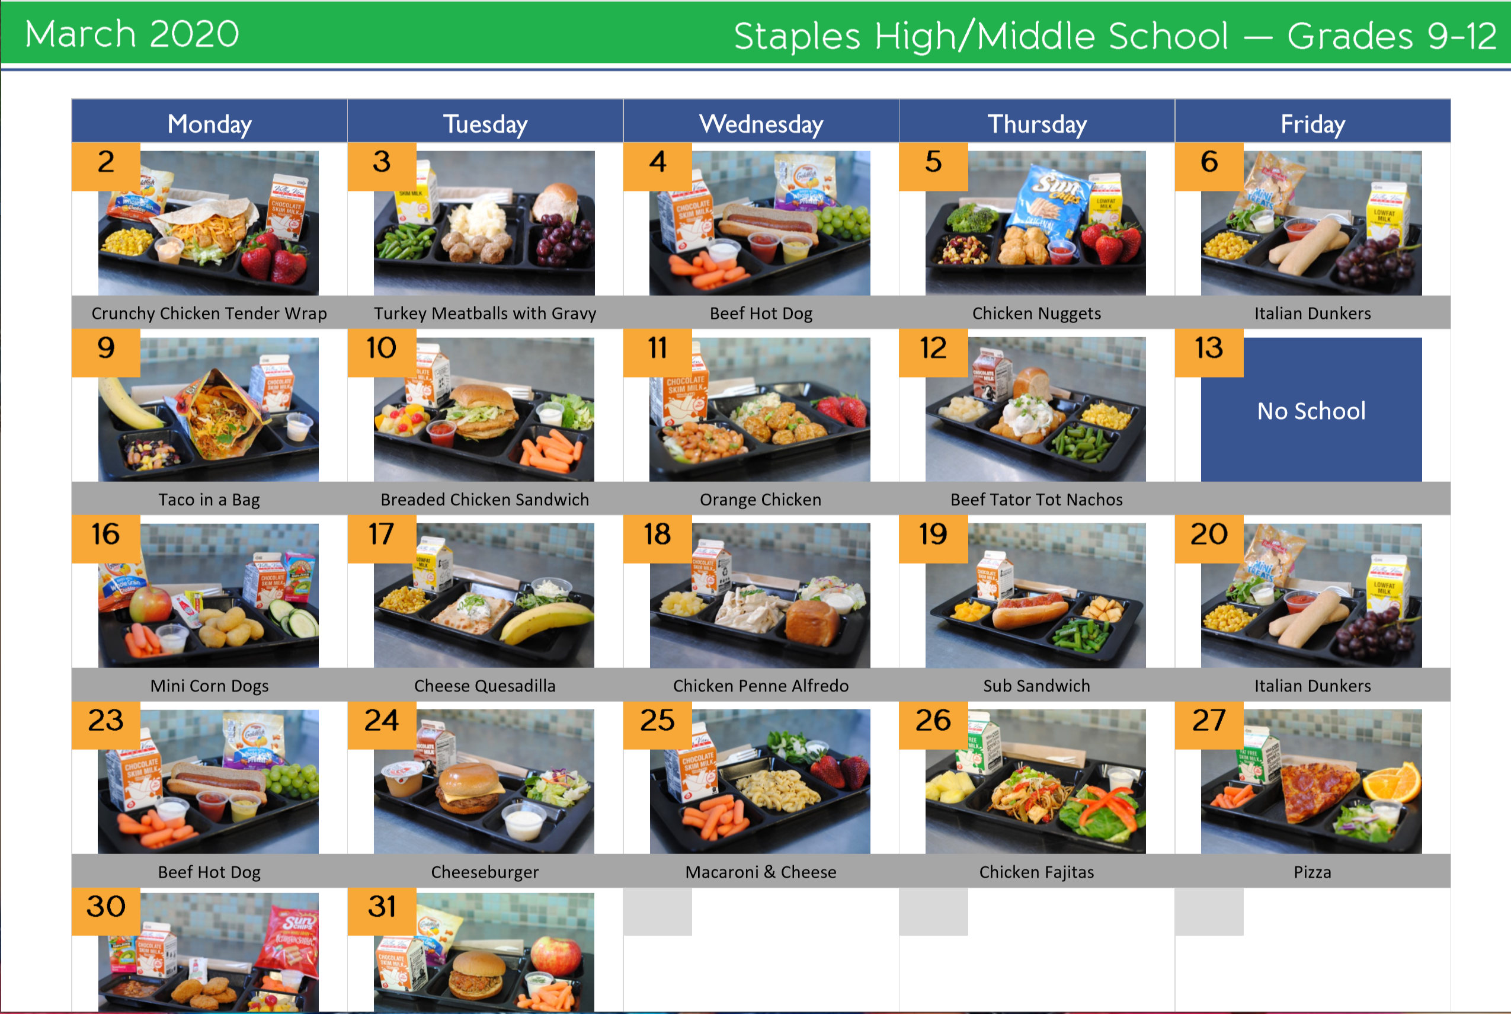
Kids Eat With Their Eyes!
Daily, weekly, or monthly pictorial menus increase student and staff participation. The cook’s meal preparation and serving presentation are inspired and enhanced by these actual menu photos.
Notes:
Value-added features:
Promotional support with customizable Calendar Creator, pictorial menus, digital display images and daily menu posters

Slide 6
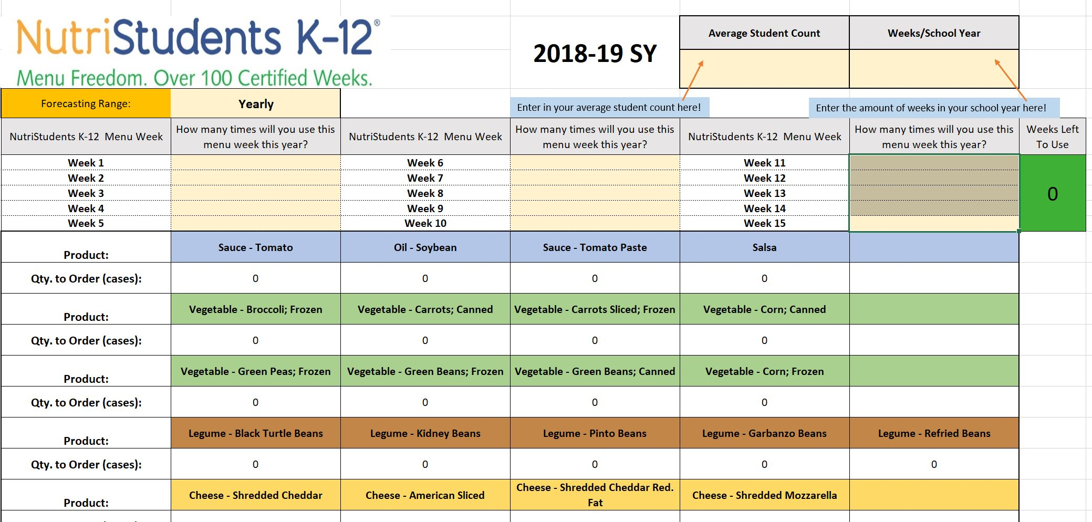
Tools to simplify commodity and product ordering
Our making full use of your USDA Foods (Commodities) first is one way to ensure the financial success of your foodservice program.
Our USDA Commodity Calculator does in 15 minutes what foodservice directors often spend 30 or more hours/year figuring out, with 90% accuracy!
DataBites™ Inventory and semi-automated Order Management System saves 1-2 hours per week
USDA Commodity Forecasting Tool
Notes:
Value-added features:
USDA Commodity Forecasting Tool

Slide 7
Value Adds
Helps school foodservice programs remain self-operated and profitable
Breakfast Menu Builder builds a year’s worth of menus in minutes, saving hours of work and helping increase typical breakfast participation to over 50%
USDA Administrative Review and ongoing support
CookBook scales recipes instantly to the number of students served, saving 2-3 hours per week
USDA Commodity Calculator saves over 30 hours/year
Cafeteria posters
Promotional materials: Daily menu posters, digital display images, promotional calendar creator, monthly pictorial menus
Cafeteria Connection, a newsletter for parents and staff will greatly increase participation
Strongly supported by AASA (School Superintendents Association)

Slide 8
Examples of Real First-Year Results
Prairie Seeds Academy: Increase of 40% participation and $112,000 revenue
Park Rapids Area Schools: 30-40% reduction in plate waste
Hanover Public Schools: Daily middle school participation increase of 25% with reduced food cost/plate
Staples-Motley School District: 10% overall increase in participation with reduced food costs and first-ever budget surplus, and annual budget surplus in subsequent years

Slide 9
Your Increased Revenue Expectations
Expected first year participation/revenue increase: 10%
At $648 per student, how much increased revenue will you gain if you only increase participation by 5%?
Full money back guarantee if not satisfied with first year results
* See MenuFreedom.com for validated testimonials.

Slide 10
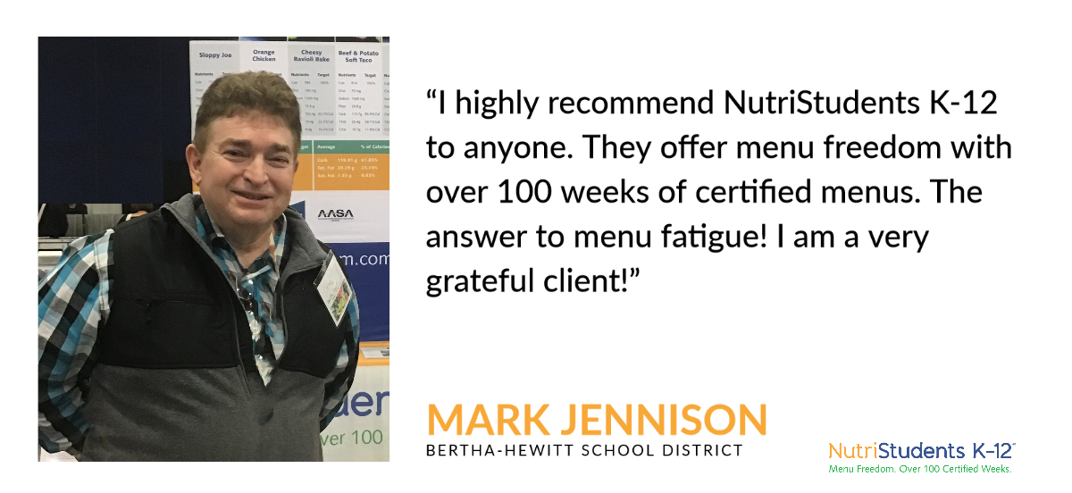
Don’t take our word for it!

Slide 11
Client Testimonials
“NutriStudents K-12 is the best thing that happened to me in my foodservice career.”
- Sue Motzko
“The kids love the food...I haven’t had one single complaint!”
- Sue Motzko
“Our food waste was decreased by as much as 30-40% less than last year.”
- Tom Marcussen
“The kids are excited about breakfast and lunch. Participation has increased much more than we expected: From 500 to 700 every day.”
- Crystal Vang
“This doesn’t look or taste like school lunch. It’s absolutely awesome!”
- Shelly Miller
“Foodservice directors would have to be out of their mind not to use this program!”
-Crystal Gauss
“I’m so pleased with my lower food cost.”
- Shelly Miller
“My whole job is easier…less time doing food prep and cooking…”
- Judy Gertz

Slide 12
Reduced cost80% of participating schools most dependent on USDA reimbursements lack resources to meet the Healthy, Hunger-Free Kids Act’s strict requirements.2 - Increased revenue - Reduced cost - Reduced waste - Reduced administrative time - Ensured RD-certified USDA compliance - 100% money-back guarantee
Only one company guarantees:

Slide 13
Love It or it’s free. Period.
If you use NutriStudents K-12 as intended for up to one year and are not fully satisfied for any reason, we will refund 100% of your first-year investment.

Slide 14
Pricing: Transparent, Concise, Risk-Free
No long-term contract.
Month-by-month subscription. Unsubscribe at any time.
Money back if not fully satisfied.
Monthly Subscription
Four schools or less $289/month
Each additional school $49/month

Slide 15
Questions? Amanda@NutriStudentsK-12.com 909-646-0374
No matter what direction your district takes, we’ve got you fully covered!

